Slide 1
Software Project Management
Scheduling
Dr. Seemab Latif
Lecture No. 7
21st March, 2011

Slide 2
Today
Network Fundamentals
Gantt Charts
PERT/CPM Techniques
Mid-term review
Notes:
No lab today
More lab in later term

Slide 3
Previous Lectures Review
Planning
WBS
Estimation

Slide 4
WBS
Types: Process, product, hybrid
Formats: Outline or graphical org chart
High-level WBS does not show dependencies or durations
What hurts most is what’s missing
Becomes input to many things, esp. schedule

Slide 5
Estimation
“The single most important task of a project: setting realistic expectations. Unrealistic expectations based on inaccurate estimates are the single largest cause of software failure.” Futrell, Shafer, Shafer, “Quality Software Project Management”

Slide 6
Estimation
History is your best ally
Especially when using LOC, function points, etc.
Use multiple methods if possible
This reduces your risk
If using “experts”, use two
Get buy-in
Remember: it’s an iterative process!
Know your “presentation” techniques

Slide 7
Estimation
Bottom-up
More work to create but more accurate
Often with Expert Judgment at the task level
Top-down
Used in the earliest phases
Usually with/as Analogy or Expert Judgment
Analogy
Comparison with previous project: formal or informal
Expert Judgment
Via staff members who will do the work
Most common technique along w/analogy
Best if multiple ‘experts’ consulted

Slide 8
Estimation
Parametric Methods
Know the trade-offs of: LOC & Function Points
Function Points
Benefit: relatively independent of the technology used to develop the system

Slide 9
Your Early Phase Processes
Initial Planning:
Why
SOW, Charter
What/How (partial/1st pass)
WBS
Other planning documents
Software Development Plan, Risk Mgmt., Cfg. Mgmt.
Estimating
Size (quantity/complexity) and Effort (duration)
Iterates
Scheduling
Begins along with 1st estimates
Iterates

Slide 10
Scheduling

Slide 11
Scheduling
Once tasks (from the WBS) and size/effort (from estimation) are known: then schedule
Primary objectives
Best time
Least cost
Least risk
Secondary objectives
Evaluation of schedule alternatives
Effective use of resources
Communications

Slide 12
Terminology
Precedence:
A task that must occur before another is said to have precedence of the other
Concurrence:
Concurrent tasks are those that can occur at the same time (in parallel)
Leads & Lag Time
Delays between activities
Time required before or after a given task

Slide 13
Terminology
Milestones
Have a duration of zero
Identify critical points in your schedule
Shown as inverted triangle or a diamond
Often used at “review” or “delivery” times
Or at end or beginning of phases
Ex: Software Requirements Review (SRR)
Ex: User Sign-off
Can be tied to contract terms

Slide 14
Terminology– Example Milestones

Slide 15
Terminology
Slack & Float
Float & Slack: synonymous terms
Free Slack
Slack an activity has before it delays next task
Total Slack
Slack an activity has before delaying whole project
Slack Time T_{S} = T_{L} – T_{E}
T_{E} = earliest time an event can take place
T_{L} = latest date it can occur without extending project’s completion date

Slide 16
Scheduling Techniques
Mathematical Analysis
Network Diagrams
PERT
CPM
GERT
Bar Charts
Milestone Chart
Gantt Chart

Slide 17
Network Diagrams
Developed in the 1950’s
A graphical representation of the tasks necessary to complete a project
Visualizes the flow of tasks & relationships

Slide 18
Mathematical Analysis
PERT
Program Evaluation and Review Technique
CPM
Critical Path Method
Sometimes treated synonymously
All are models using network diagrams

Slide 19
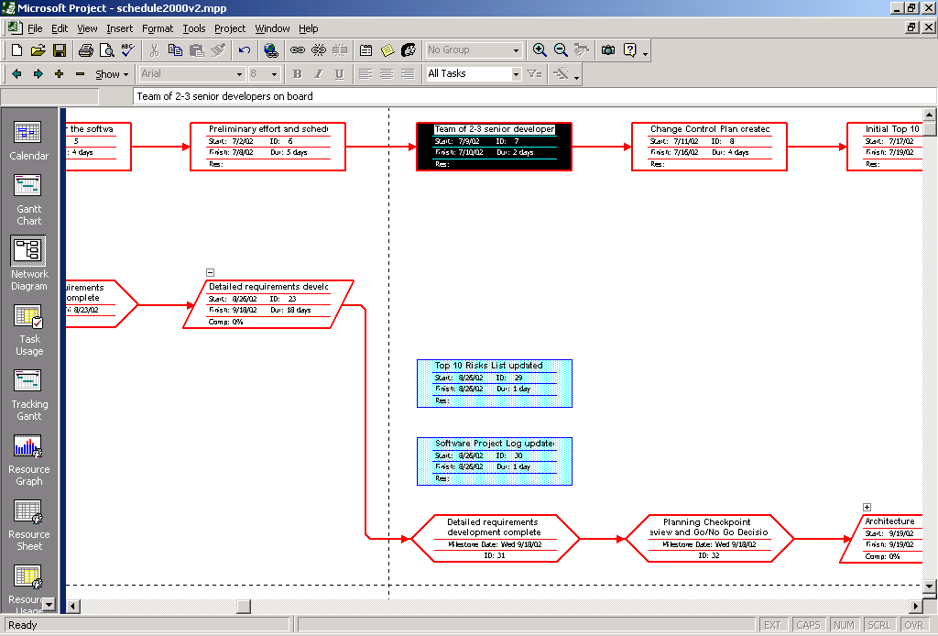
MS-Project Example

Slide 20
Network Diagrams
Two classic formats
AOA: Activity on Arrow
AON: Activity on Node
Each task labeled with
Identifier (usually a letter/code)
Duration (in std. unit like days)
There are other variations of labeling
There is 1 start & 1 end event
Time goes from left to right

Slide 21
Node Formats

Slide 22
Network Diagrams
AOA consists of
Circles representing Events
Such as ‘start’ or ‘end’ of a given task
Lines representing Tasks
Thing being done ‘Build UI’
a.k.a. Arrow Diagramming Method (ADM)
Burst and Merge
AON
Tasks on Nodes
Nodes can be circles or rectangles (usually latter)
Task information written on node
Arrows are dependencies between tasks
a.k.a. Precedence Diagramming Method (PDM)

Slide 23
Critical Path
“The specific set of sequential tasks upon which the project completion date depends”
or “the longest full path”
All projects have a Critical Path
Accelerating non-critical tasks do not directly shorten the schedule

Slide 24
Critical Path Example
Path 1: AGHI= 3+4+3+2 = 12 days
Path 2 ABCEI = 3+2+2+4+2 = 13 days Critical Path
Path 3 ABDF! = 3+2+3+1+2 = 11days

Slide 25
CPM
Critical Path Method
The process for determining and optimizing the critical path
Series of activities that determine earliest time by which the project can be completed
It is the longest path through the network diagram and has least amount of slack or float
Non-CP tasks can start earlier or later without impacting completion date
Note: Critical Path may change to another as you shorten the current task

Slide 26
4 Task Dependency Types
Mandatory Dependencies
“Hard logic” dependencies
Nature of the work dictates an ordering
Ex: Coding has to precede testing
Ex: UI design precedes UI implementation
Discretionary Dependencies
“Soft logic” dependencies
Determined by the project management team
Process-driven
Ex: Discretionary order of creating certain modules

Slide 27
4 Task Dependency Types
External Dependencies
Outside of the project itself
Ex: Release of 3rd party product; contract signoff
Ex: stakeholders, suppliers, Y2K, year end
Resource Dependencies
Two task rely on the same resource
Ex: You have only one DBA but multiple DB tasks

Slide 28
Task Dependency Relationships
Finish-to-Start (FS)
B cannot start till A finishes
A: Construct fence; B: Paint Fence
Start-to-Start (SS)
B cannot start till A starts
A: Project work started, B: Project management activities started
Finish-to-Finish (FF)
B cannot finish till A finishes
A: Add wiring; B: Inspect electrical
Start-to-Finish (SF)
B cannot finish till A starts (rare)

Slide 29
Example Step 1

Slide 30
Forward Pass
To determine early start (ES) and early finish (EF) times for each task
Work from left to right
Adding times in each path
Rule: when several tasks converge, the ES for the next task is the largest of preceding EF times

Slide 31
Example Step 2

Slide 32
Backward Pass
To determine the last finish (LF) and last start (LS) times
Start at the end node
Compute the bottom pair of numbers
Subtract duration from connecting node’s earliest start time

Slide 33
Example Step 3

Slide 34
Example Step 4

Slide 35
Slack & Reserve
How can slack be negative?
What does that mean?
How can you address that situation?

Slide 36
Slack & Reserve

Slide 37
Network Diagrams
Advantages
Show precedence well
Reveal interdependencies not shown in other techniques
Ability to calculate critical path
Ability to perform “what if” exercises
Disadvantages
Default model assumes resources are unlimited
You need to incorporate this yourself (Resource Dependencies) when determining the “real” Critical Path
Difficult to follow on large projects

Slide 38
PERT
Program Evaluation and Review Technique
Based on idea that estimates are uncertain
Therefore, uses duration ranges
And the probability of falling to a given range
Uses an “expected value” (or weighted average) to determine durations
Use the following methods to calculate the expected durations, then use as input to your network diagram

Slide 39
PERT
Start with 3 estimates
Optimistic
Would likely occur 1 time in 20
Most likely
Modal value of the distribution
Pessimistic
Would be exceeded only one time in 20

Slide 40
PERT Formula
Combined to estimate a task duration

Slide 41
PERT Formula
Confidence Interval can be determined
Based on a standard deviation of the expected time
Using a bell curve (normal distribution)
For the whole critical path use

Slide 42
PERT-- Three Steps
PERT Technique uses following three steps to calculate the probability of meeting or missing the target date:
Calculate standard deviation
Calculate z value
Convert z value to percentage

Slide 43
PERT Example
Description | Planner 1 | Planner 2
m | 10d | 10d
a | 9d | 9d
b | 12d | 20d
PERT time | 10.16d | 11.5d
Std. Dev. | 0.5d | 1.8d
Confidence interval for P2 is 4 times wider than P1 for a given probability
Ex: 68% probability of 9.7 to 11.7 days (P1) vs. 9.5-13.5 days (P2)

Slide 44
PERT
Advantages
Accounts for uncertainty
Disadvantages
Time and labor intensive
Assumption of unlimited resources is big issue
Lack of functional ownership of estimates
Mostly only used on large, complex project
Get PERT software to calculate it for you

Slide 45
CPM vs. PERT
Both use Network Diagrams
CPM: deterministic
PERT: probabilistic
CPM: one estimate, PERT, three estimates
PERT is infrequently used

Slide 46
Milestone Chart
Sometimes called a “bar charts”
Simple Gantt chart
Either showing just highest summary bars
Or milestones only

Slide 47
Bar Chart

Slide 48
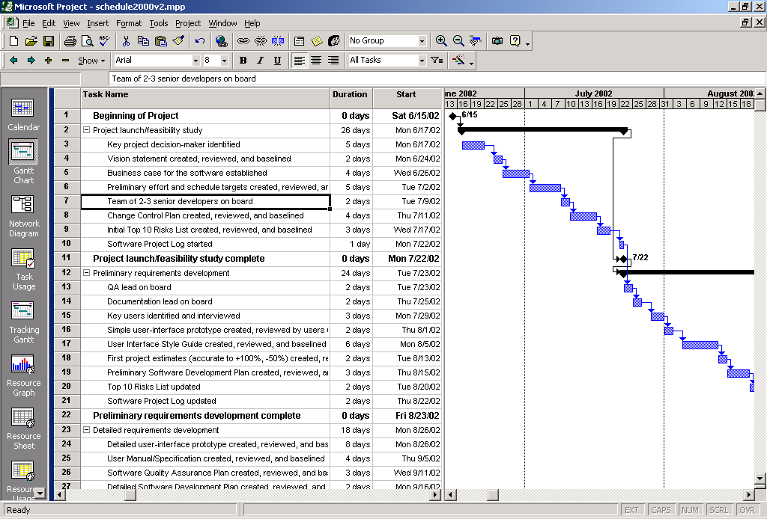
Gantt Chart

Slide 49
Gantt Chart
Disadvantages
Does not show interdependencies well
Does not uncertainty of a given activity (as does PERT)
Advantages
Easily understood
Easily created and maintained
Note: Software now shows dependencies among tasks in Gantt charts
In the “old” days Gantt charts did not show these dependencies, bar charts typically do not

Slide 50
Reducing Project Duration
How can you shorten the schedule?
Via
Reducing scope (or quality)
Adding resources
Concurrency (perform tasks in parallel)
Substitution of activities

Slide 51
Compression Techniques
Shorten the overall duration of the project
Crashing
Looks at cost and schedule tradeoffs
Gain greatest compression with least cost
Add resources to critical path tasks
Limit or reduce requirements (scope)
Changing the sequence of tasks
Fast Tracking
Overlapping of phases, activities or tasks that would otherwise be sequential
Involves some risk
May cause rework

Slide 52
Review - Fundamentals
Projects, programs, products
McConnell’s four dimensions
Classic mistakes
Know a set of these
Remember by “type”
People, process, product, technology related

Slide 53
Review
Trade-offs & constraints
The triangle
Cost, Time, Scope
(And Quality)
PMI processes and knowledge areas
Process groups
Organizational structures
Advantages & disadvantages of each form

Slide 54
Review
Classic project phases
As covered in class
Key documents at each phase
SOW, Charter
Project Management Plan
Identify key planning documents

Slide 55
Review - Lifecycle
Methodologies
Trade-offs
Basic Pros & Cons
Given a specific scenario decide what SDLC is most appropriate
Waterfall process
Challenges of each phase
Requirements
Criticality
Issues
Functional & Non-functional

Slide 56
Review
Wherever I gave you say 5 types of ‘things’
Like estimation techniques or methodologies
I may ask ‘Tell me two approaches to X’
Especially interested in the pros & cons
You did your readings, yes?
Text & class slides

Slide 57
Review – Estimate & Schedule
Four primary steps
Define work to be done (WBS)
Estimate size
Estimate effort
Build schedule

Slide 58
Review - WBS
Types: Process, product, hybrid
Formats: Outline or graphical org chart
Shows hierarchical task relationships
High-level version does not show dependencies or durations
What hurts most is what’s missing
Becomes input to many things, esp. schedule

Slide 59
Review – Estimation
Size Estimation Techniques
Bottom-up vs. Top-down
Analogy
Expert Judgment
Parametric (not the formulas, just the gist)
Function Points
LOC
Schedule presentation techniques
Q3, 6-8 months, best/worst case

Slide 60
Review - Scheduling
Dependencies
Types: mandatory, etc.
Relationships: FS, SF, etc.
Network Diagrams
CPM
PERT
Schedule Optimization Techniques

